Slide 1
RESPONSIVE BLOG
FWD PROJECT
Presented By:
Student Name:Yashas B.N
College Name:Seshadripuram Degree College
Department:B.C.A

Slide 2
OUTLINE
Problem Statement
System Development Approach
Algorithm & Deployment
Result
Conclusion
Future Scope
References

Slide 3
Problem Statement
Writers need a simple, responsive platform to publish and manage posts.
Traditional CMS platforms can be too complex for basic blogging needs.
This project aims to build a clean, mobile-friendly blog template with posts rendered dynamically from JSON or local data.

Slide 4
System Approach
Frontend Technologies:
HTML5 – Structure of the webpage
CSS3 – Styling and responsive layouts
JavaScript – Dynamic interactivity (cart, filtering, total calculation)
Design Approach:
Clean and user-friendly interface
Mobile-responsive design
Modular separation of HTML, CSS, and JS files

Slide 5
Algorithm & Deployment
Dynamic Content Rendering
Modular templates for easy content structure.
Facilitates quick updates and content seperation
Frontend Design
Layout using HTML and CSS (grid & cards).
Interactive Features
Dark Mode Toggle for enhanced readability and reduced eye stress.
Modal Galleries.
Testing
Cross-browser compatibility
Mobile responsiveness
Deployment
Host using GitHub Pages / Netlify for free and easy access.

Slide 6
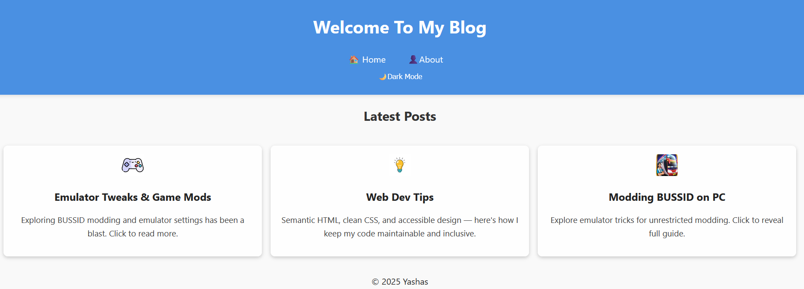
Result
GitHub Link:https://yashasbn0-ui.github.io/Welcome-to-Yashas-Blog/

Slide 7
Conclusion
Modularity:Easy to extend and maintain.
Visual Appleal:Modern Design,dark mode integration.
Clean Code:Maintainable and efficient codebase.

Slide 8
Future scope(Optional)
Multi-User Suport:Enable multiple authors and content creators.
AI Content Suggestions.
Backend for Comments.

Slide 9
References
Site relevant sources instrumental in developing the proposed solution.
MDN Web Docs
W3 Schools
GitHub: To Deploy and test project

Slide 10
THANK YOU

